Slide 1
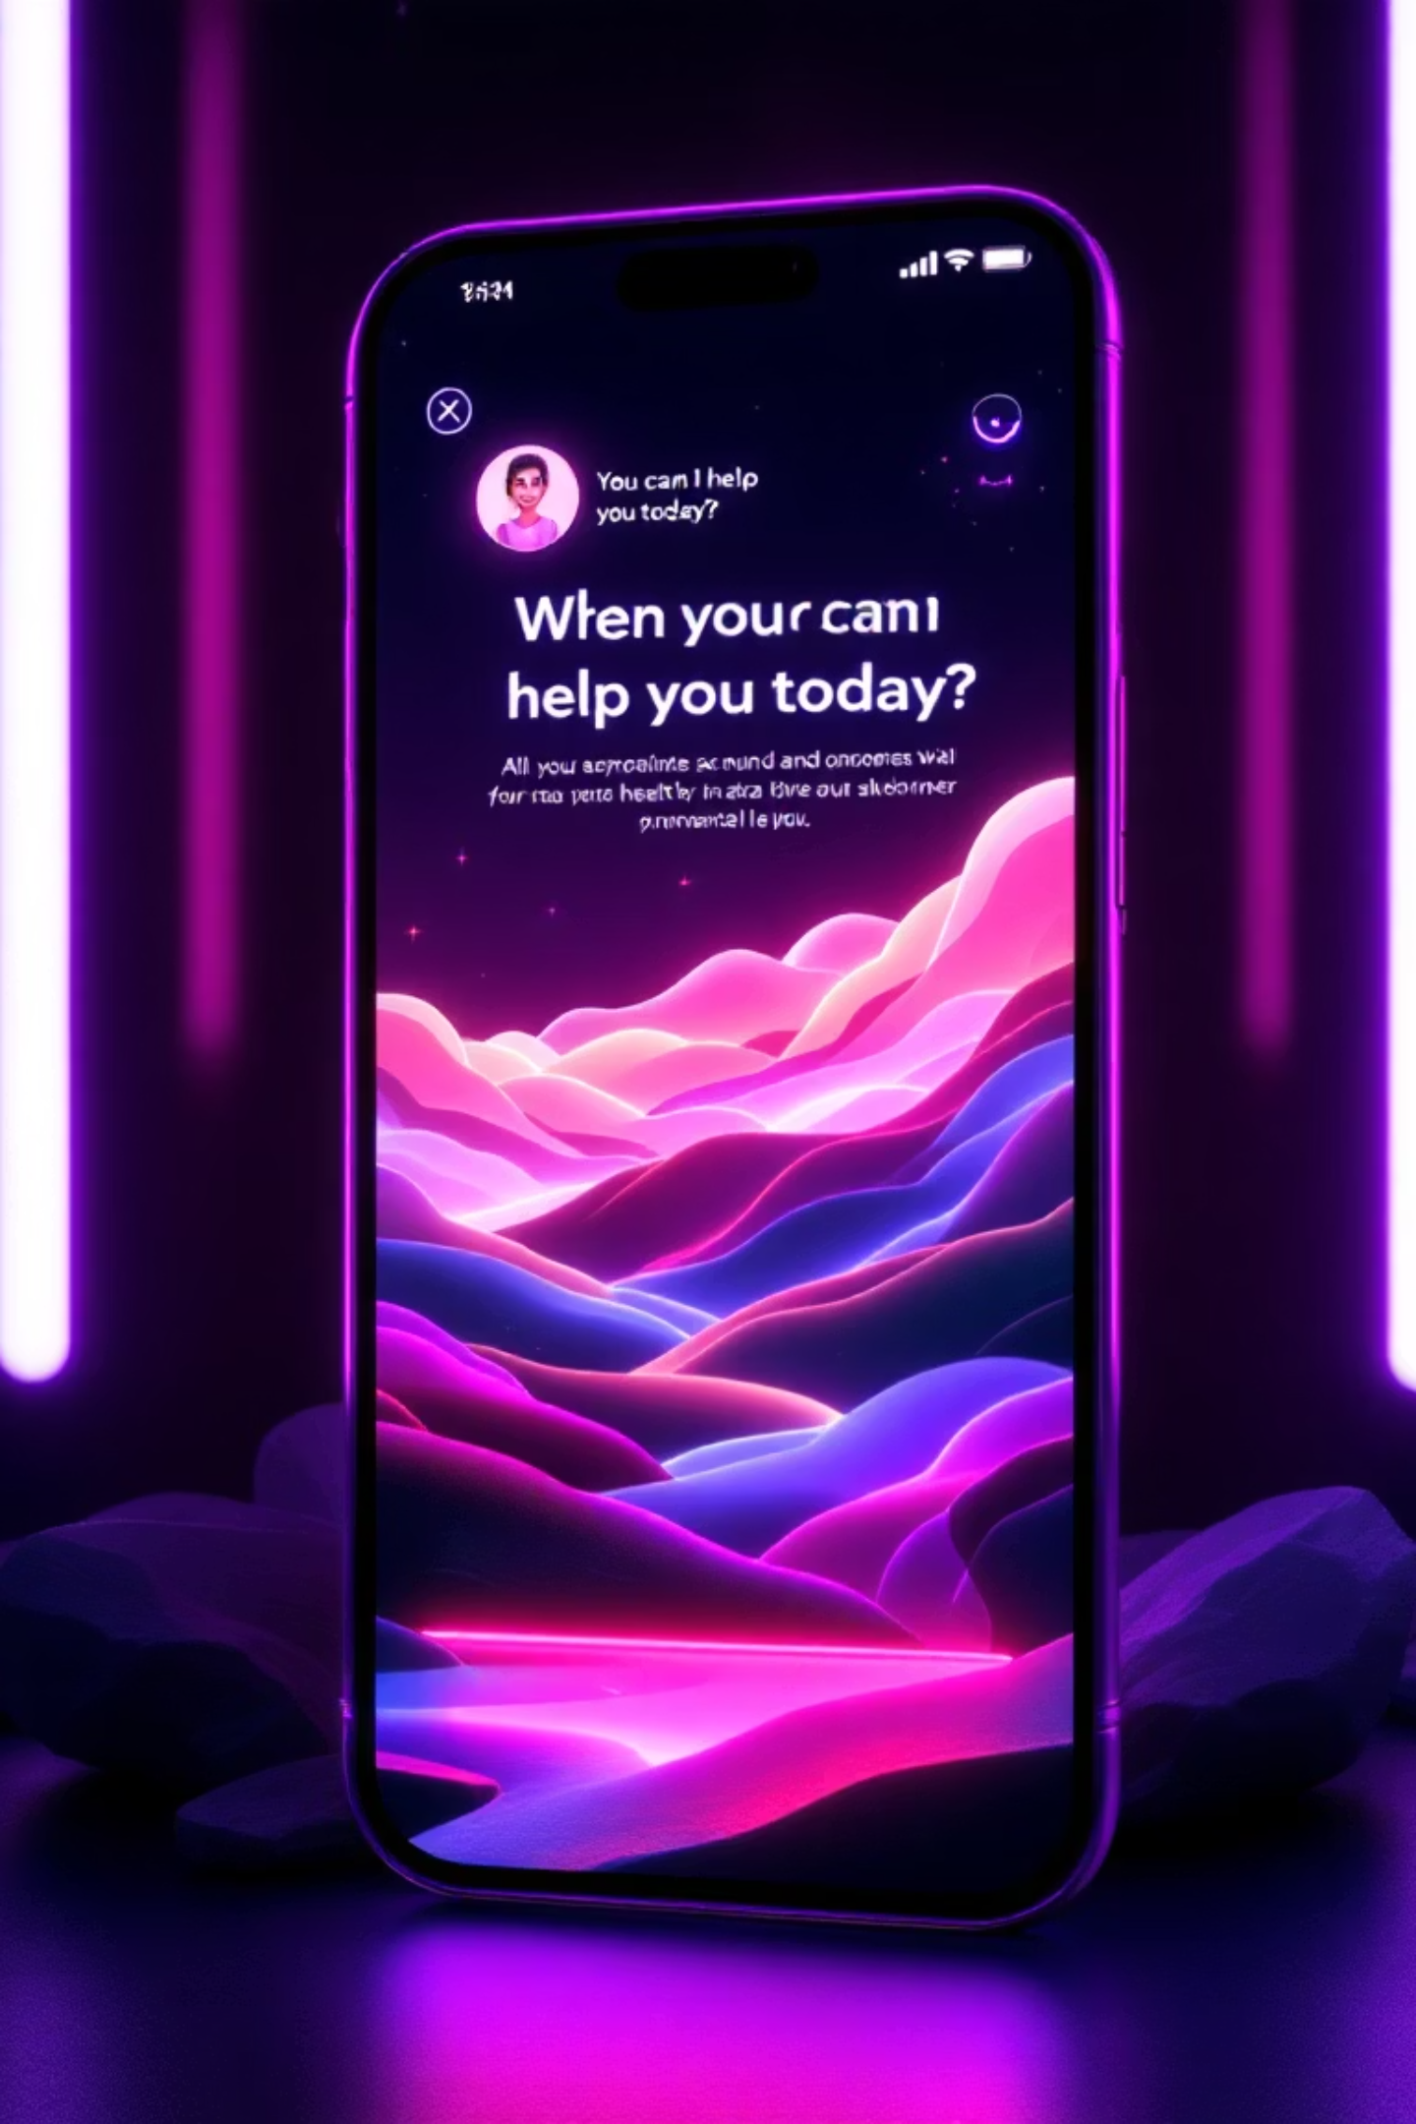
Emotion-Aware Mental Health Chatbot
By: Arjun K & Noor Muhammed anwar
Building empathetic technology to support mental wellness

Slide 2
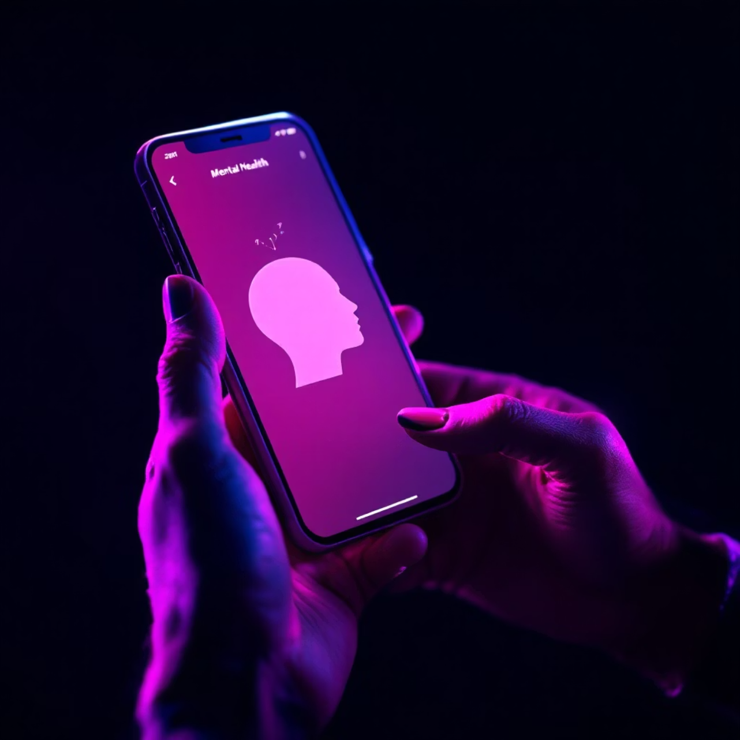
The Growing Need for Mental Health Support
Mental health challenges are escalating worldwide, yet many individuals hesitate to seek professional support due to persistent stigma and accessibility barriers.
Our innovative chatbot creates a safe, private, and accessible platform that provides 24/7 emotional support without judgment.
This technology bridges the gap between immediate need and professional care, offering empathetic assistance when it matters most.

Slide 3
Project Objectives
Emotion Detection
Empathetic Responses
Advanced recognition of user emotions through both text and voice inputs
Contextually appropriate, supportive replies that demonstrate understanding and compassion
Support for many languages.
Secure Data Management
Seamless communication in English and regional languages to ensure broad accessibility
Safe storage of chat history with privacy as a priority.
Our mission centres on creating technology that truly understands and responds to human emotional needs with accessibility through text, voice, and translations.

Slide 4






Comprehensive Technology Stack
Framework
Django - web framework providing secure user authentication and scalable architecture
Database
Django ORM - Efficient data management for user profiles and conversation history
AI Engine
Ollama – Advanced language model (Gemma 7B) generating contextually empathetic responses.
Speech Processing
Whisper & pyttsx3 - Seamless voice-to-text and text-to-speech capabilities
Translation
Google Translator API - Real-time multilingual communication support
Frontend
HTML, CSS, JavaScript - user interface through Django templates

Slide 5
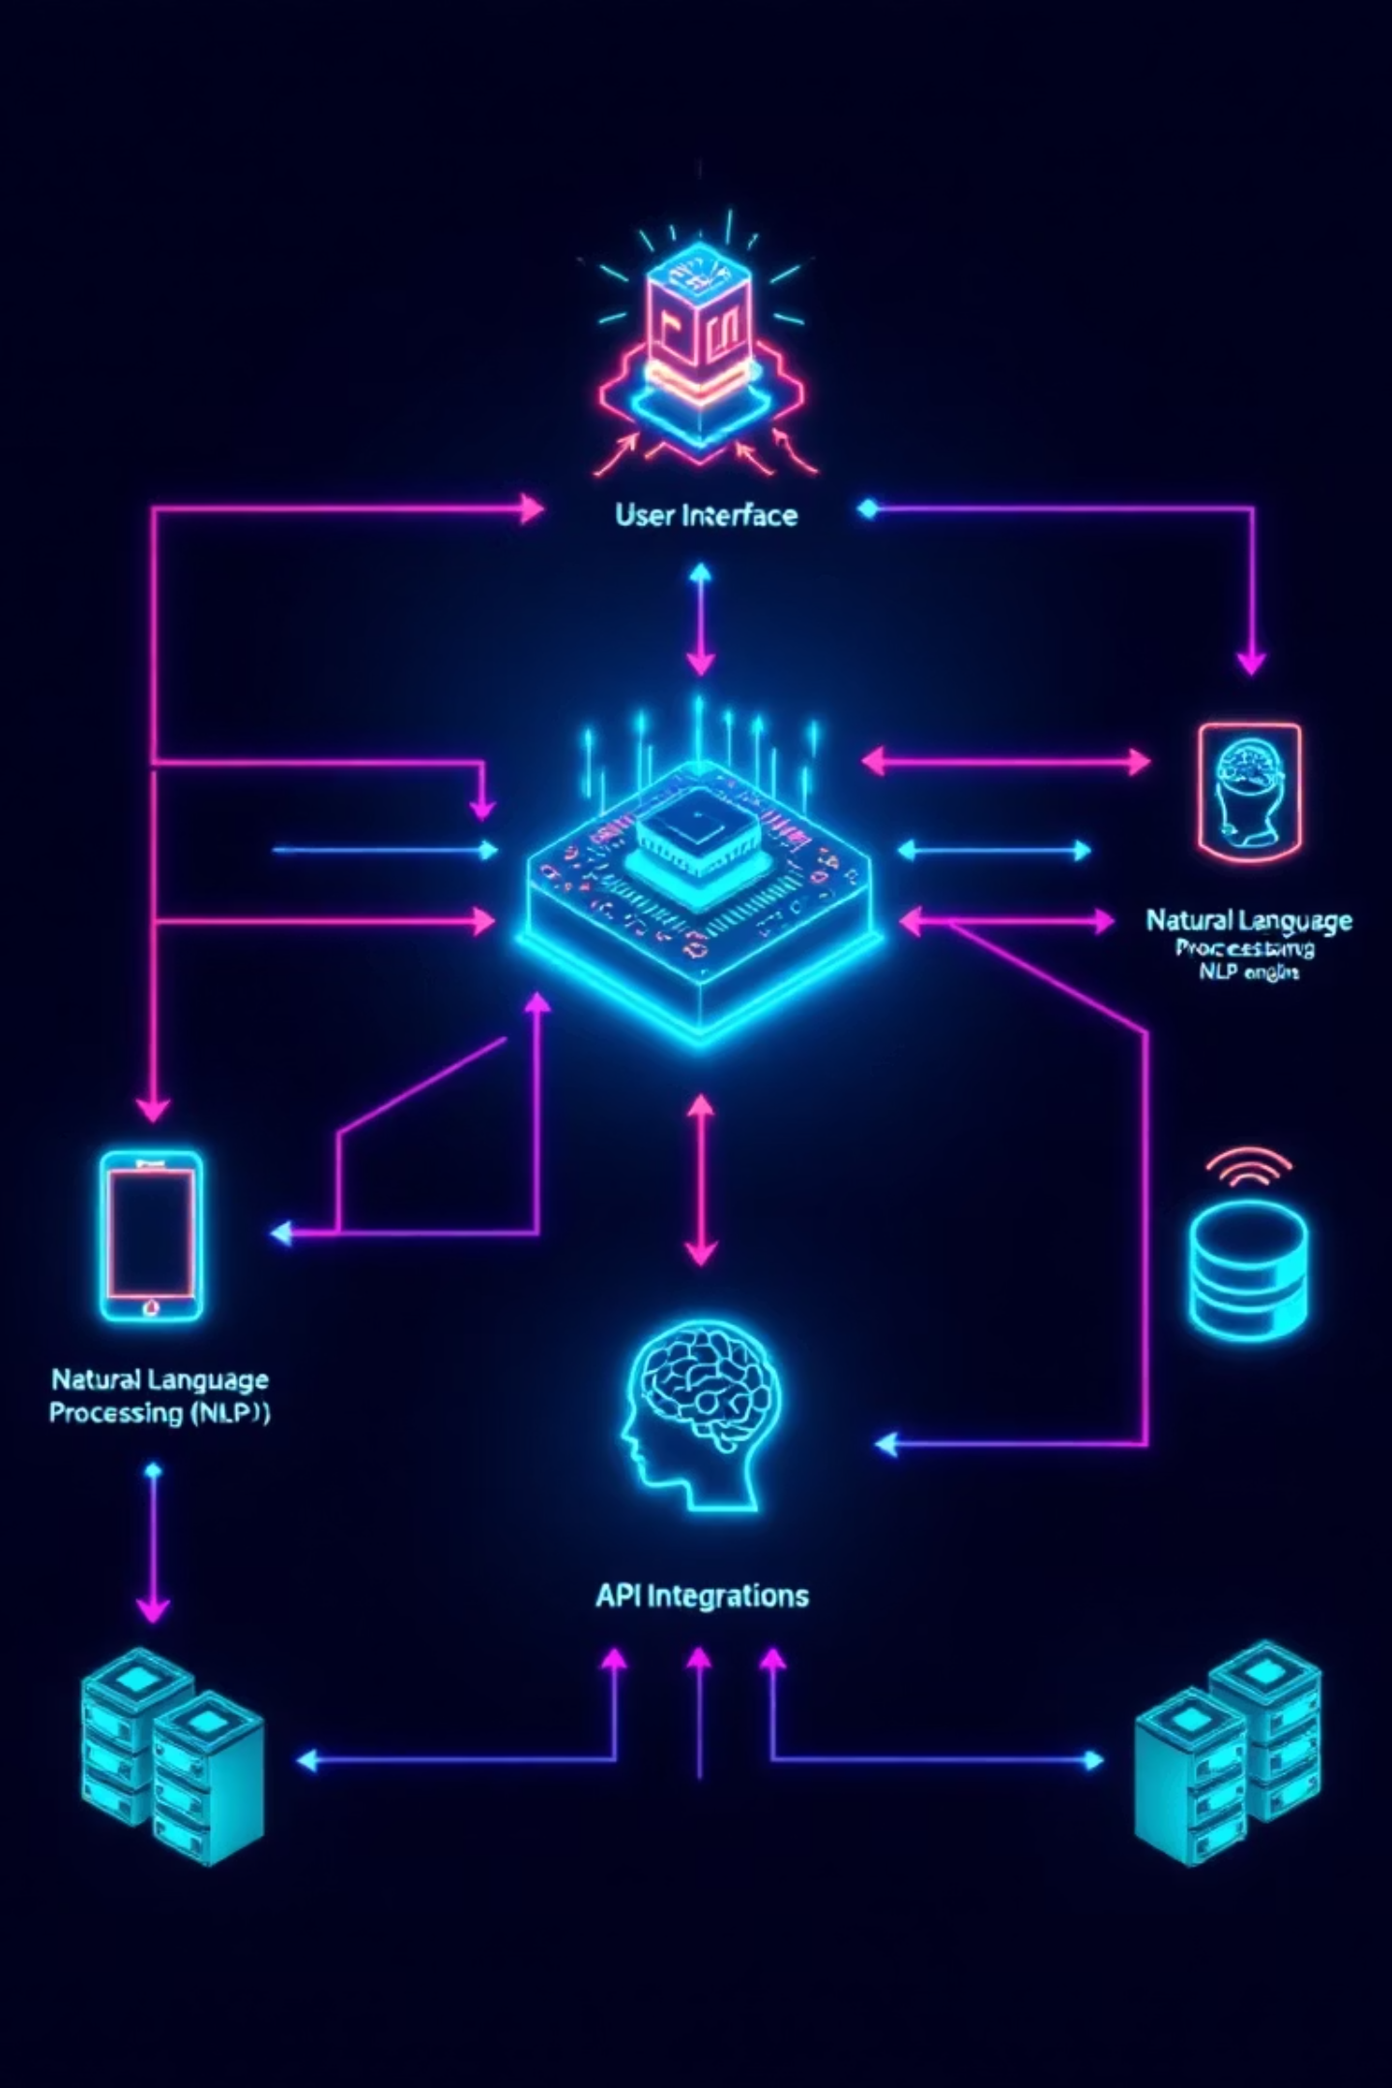




System Architecture Overview
User Input
Text or voice message is received through the interface.
Processing
Data preprocessing
Response Generation
AI generates empathetic, contextually appropriate replies
Output
The reply is shown as text and spoken through audio
Frontend Components
Backend Services
Secure login system
Django authentication views
Interactive chat interface
Conversation management
Voice upload functionality
Speech processing services

Slide 6
Comprehensive Feature Set
Secure User Authentication
Complete registration, login, and logout system ensuring user privacy and data protection
Real-time Empathetic Chat
Intelligent conversation engine providing emotion-aware responses with contextual understanding
Advanced Voice Integration
Seamless voice-to-text recognition and text-to-speech synthesis for accessible communication
multilanguages Translation
Bidirectional translation between English and regional languages including Malayalam support
Comprehensive History Management
Secure storage, viewing, and clearing of conversation history with personalised user profiles

Slide 7
User Experience Workflow
Authentication
1
User securely logs in or creates new account with privacy protection
2
Input Method Selection
Choice between typing text message or recording voice input for maximum accessibility
Speech Processing
3
Voice messages automatically converted to text using advanced Whisper technology
4
Emotion Analysis
System analyses emotional context and generates contextually appropriate empathetic response
Response Delivery
5
Reply displayed in chat interface and spoken aloud through text-to-speech synthesis
6
Additional Options
Users can translate responses or manage conversation history as needed

Slide 8

Future Enhancements
Advanced emotion detection algorithms
Integration with professional counselling services
Extended multilingual capabilities
Mobile application development

Slide 9


